Slide 1
Chapter 0: Introduction to Programming in R
Instructor: Yanhui Guo, Ph.D

Slide 2
Outlines
What is R
Getting start with R
Importing Data
Working with data
Creating a Vector
Creating a Data Frame
Random Number Generation

Slide 3
What is R?
The R statistical programming language is a free open source package based on the S language developed by Bell Labs.
The language is very powerful for writing programs.
Many statistical functions are already built in.
Contributed packages expand the functionality to cutting edge research.
Since it is a programming language, generating computer code to complete tasks is required.

Slide 4
Getting Started
Where to get R?
Go to www.r-project.org
Downloads: CRAN
Set your Mirror: Anyone in the USA is fine.
Select Download R for Windows.
Select base.
Select R 3.4.3 for Windows
The others are if you are a developer and wish to change the source code.

Slide 5
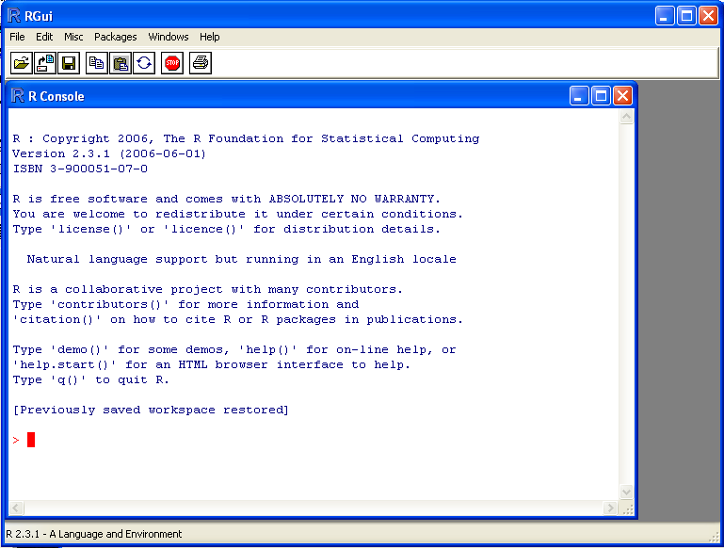
Getting Started
The R GUI?

Slide 6
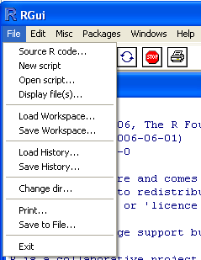
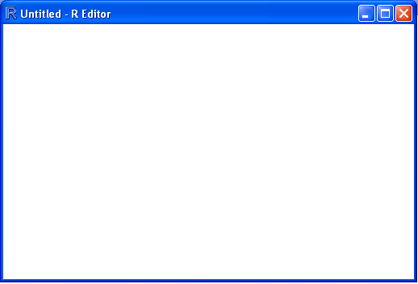
Getting Started
Opening a script.
This gives you a script window.

Slide 7
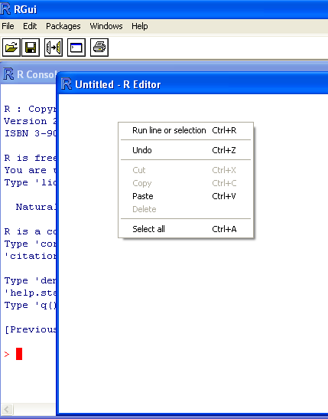
Getting Started
Submit Selection
Submitting a program:
Use button
Right mouse click and run selection.

Slide 8
Getting Started
Basic assignment and operations.
Arithmetic Operations:
+, -, *, /, ^ are the standard arithmetic operators.
Matrix Arithmetic.
* is element wise multiplication
%*% is matrix multiplication
Assignment
To assign a value to a variable use “<-”

Slide 9
Getting Started
How to use help in R?
R has a very good help system built in.
If you know which function you want help with simply use ?_______ with the function in the blank.
Ex: ?hist.
If you don’t know which function to use, then use help.search(“_______”).
Ex: help.search(“histogram”).

Slide 10
Importing Data
How do we get data into R?
Remember we have no point and click…
First make sure your data is in an easy to read format such as CSV (Comma Separated Values).
Use code:
D <- read.table(“path”,sep=“,”,header=TRUE)

Slide 11
Working with data
Accessing columns.
D has our data in it…. But you can’t see it directly.
To select a column use D$column.

Slide 12
Working with data
Subsetting data.
Use a logical operator to do this.
==, >, <, <=, >=, <> are all logical operators.
Note that the “equals” logical operator is two = signs.
Example:
D[D$Gender == “M”,]
This will return the rows of D where Gender is “M”.
Remember R is case sensitive!
This code does nothing to the original dataset.
D.M <- D[D$Gender == “M”,] gives a dataset with the appropriate rows.

Slide 13
Creating a Vector
To create a vector use the c() function
b <- c(3,1,0.3,0.1)
This creates the column vector
Notice: index of vector, matrix and list starts from 1

Slide 14
Determining the Size of a Vector
Use the length function.
n1 <- length(X1)
Use this only for vectors.
Produce different results on matrices.

Slide 15
Creating a Vector of Repeated Values
Often we want a vector of ones around.
Use the rep() function.
ones <- rep(1,n1)
This creates a vector of ones of length n1.

Slide 16
Creating a Matrix from Vectors
Use the cbind() function.
X <- cbind(ones,X1,X2,X3)
This binds the column vectors together into a matrix.

Slide 17
Create a data frame
A data frame is used for storing data tables.
It is a list of vectors of equal length.
variable df is a data frame containing three vectors n, s, b.
n = c(2, 3, 5)
s = c("aa", "bb", "cc")
b = c(TRUE, FALSE, TRUE)
df = data.frame(n, s, b)

Slide 18
Random Number Generation
Random number generation is important in simulations as well as some model fitting techniques.
Consider:
X1 <- rnorm(100,5,2)
This generates a vector of 100 normal random variables with mean 5 and standard deviation 2.

Slide 19
Random Number Generation
Generate two more vectors:
X2 <- rnorm(100,15,3)
X3 <- rnorm(100,22,5)
This gives us two more vectors of normally distributed values.

Slide 20
Create a Function
Use the function() format
reg1 <- function(Y,X){
statements
return(result)
}
Don’t forget to return the result.
Remember the code in braces is the function.

Slide 21
Loops
To construct a loop use the following structure
for(i in 1:n){
statement
}
while (test_expression) {
statement
}
repeat {
statement
}

Slide 22
If…then constructs
If you are interested in an if… then statement on a vector use the ifelse() function.
ifelse(condition, True action, False action)
Example
X1 <- rnorm(15,0,1)
X2 <- ifelse(X1<.5,1,0)
cbind(X1,X2)

Slide 23
If…then constructs
If you are not interested in a vector, then use the if{}else{} construct.
if (test_expression) {
statement
} else {
statement
}

Slide 24
Source Files
Source files allows you to store all of your created functions in a single file and have all those functions available to you.
To load a self created library use:
source(Path)
Don’t forget that \ in the path needs to be replaced with \\

Slide 25
Writing to a file
To write to a file use the write.table() function.
write.table(dataset, path, sep=“,”, row.names=FALSE, col.names=FALSE)
This will produce a comma separated value (csv) file.

Slide 26
Summary
R is programming environment with many standard programming structures already included.
Easy to create functions.
Allows users to create a library of functions.

Slide 27
Chapter 1 R Basics
Instructor: Yanhui Guo, Ph.D.

Slide 28
Outlines
Install packages
Load a package
Load a Delimited Text Data File
Load Data from an Excel File
Load Data from an SPSS File

Slide 29
1.1. Installing a Package
Problem
Install a package from CRAN.

Slide 30
1.1. Installing a Package
Solution
Use install.packages()
Give it the name of the package you want to install.
Example:
To install ggplot2, run:
install.packages("ggplot2")

Slide 31
1.1. Installing a Package
Discussion
To install a package, R will automatically install any other packages that the first package depends on.
CRAN is a repository of packages for R
It’s the default repository system used by R.

Slide 32
1.2. Loading a Package
Problem
Load an installed package.

Slide 33
1.2. Loading a Package
Solution:
Use library()
Give it the name of the package you want to install.
The package must already be installed on the computer.
Example
To load ggplot2, run:
library(ggplot2)

Slide 34
1.2. Loading a Package
Discussion
Require loading a package before running the code for the graphing capabilities and example data sets
Package/library
use the library() function to load a package, a package is not a library
A library is a directory that contains a set of packages.
Package includes functions, data and belongs to one library.

Slide 35
1.3. Loading a Delimited Text Data File
Problem
Load data from a delimited text file.

Slide 36
1.3. Loading a Delimited Text Data File
Solution
most common way to read in a file is to use comma-separated values (CSV) data:
Example:
data <-read.csv("datafile.csv")

Slide 37
1.3. Loading a Delimited Text Data File
Discussion
Since data files have many different formats, there are many options for loading them.
If the data file does not have headers in the first row:
data <-read.csv("datafile.csv",header=FALSE)
The resulting data frame will have columns named V1, V2, and so on,
Rename them manually:
names(data) <-c("Column1","Column2","Column3")

Slide 38
1.3. Loading a Delimited Text Data File
Discussion
set the delimiter with sep.
If it is space-delimited, use sep=" ".
If it is tab delimited, use \t
data <-read.csv("datafile.csv",sep="\t")
strings in the data are treated as factors.
To differentiate this, set stringsAsFactors=FALSE.
data <-read.csv("datafile.csv",stringsAsFactors=FALSE)
convert them individually as factor:
# Convert to factor
data$Sex <-factor(data$Sex)

Slide 39
1.4. Loading Data from an Excel File
Problem
load data from an Excel file

Slide 40
1.4. Loading Data from an Excel File
Solution
xlsx package has the function read.xlsx() for reading Excel files.
Read the first sheet of an Excel spreadsheet:
install.packages("xlsx")
library(xlsx)
data <-read.xlsx("datafile.xlsx", 1)

Slide 41
1.4. Loading Data from an Excel File
Solution
For reading older Excel files in the .xls format, the gdata package has the function read.xls():
install.packages("gdata")
library(gdata)
data <-read.xls("datafile.xls")

Slide 42
1.4. Loading Data from an Excel File
Discussion
read.xlsx() can load from other sheets by specifying a number for sheetIndex or a name for sheetName:
data <-read.xlsx("datafile.xls",sheetIndex=2)
data <-read.xlsx("datafile.xls",sheetName="Revenues")
read.xls() can load from other sheets by specifying a number for sheet:
data <-read.xls("datafile.xls",sheet=2)

Slide 43
1.4. Loading Data from an Excel File
Discussion
Both the xlsx and gdata packages require other software to be installed on your computer.
For xlsx, you need to install Java on your machine. For gdata, you need Perl,
On Windows, you’ll need ActiveState Perl.

Slide 44
1.5. Loading Data from an SPSS File
Problem
Load data from an SPSS file.

Slide 45
1.5. Loading Data from an SPSS File
Solution
The foreign package has the function read.spss() for reading SPSS files.
To load data from the first sheet of an SPSS file:
install.packages("foreign")
library(foreign)
data <-read.spss("datafile.sav")

Slide 46
1.5. Loading Data from an SPSS File
Discussion
The foreign package also includes functions to load from other formats
including:
read.octave(): Octave and MATLAB
read.systat(): SYSTAT
read.xport(): SAS XPORT
read.dta(): Stata

Slide 47
Summary
Install packages
Load a package
Load a Delimited Text Data File
Load Data from an Excel File
Load Data from an SPSS File

